Slide 1
Data exploratıon report
GROUP E-SPOR

Slide 2
The Source of Data
https://data.oecd.org/trade/current-account-balance.htm
https://data.oecd.org/natincome/value-added-by-activity.htm
https://data.oecd.org/gdp/gross-domestic-product-gdp.htm
Charts:
https://data.oecd.org/chart/5CTB
https://data.oecd.org/chart/5CTC
https://data.oecd.org/chart/5CTE
https://data.oecd.org/chart/5CTD
https://data.oecd.org/chart/5CTF
https://data.oecd.org/chart/5CTG

Slide 3
Feature List
We are going to analyze;
Current Account in GDP as percentage and margin of percentage
Such economic indicators can be used;
Domestic GDP
Foreign GDP
Growth Rate of Value-Added Activities
Domestic Credit
Fiscal Balance
Trade Openness
Oil Balance Trade
Nominal Exchange Rate

Slide 4
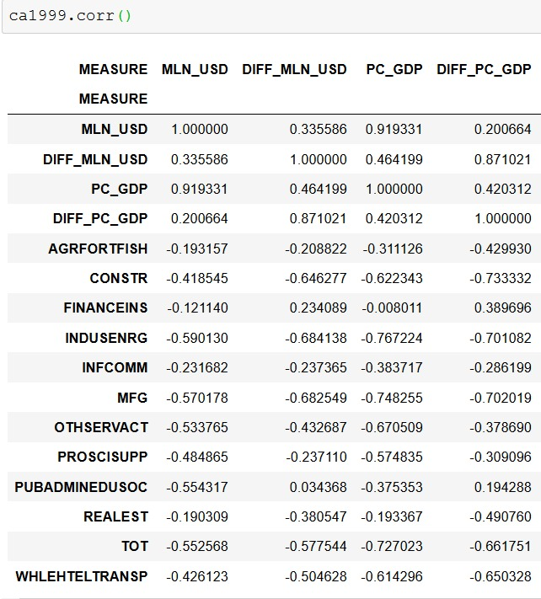
Statistical Exploration
Total value-added growth is mostly correlated with percentage in GDP (-0.7270)
On a sectoral basis, Construction, Manufacturing and Industry including Energy areas mostly correlated with Current Account
Economic indicators that are mentioned in previous slide, are mostly in relation with Current Account Balance

Slide 5
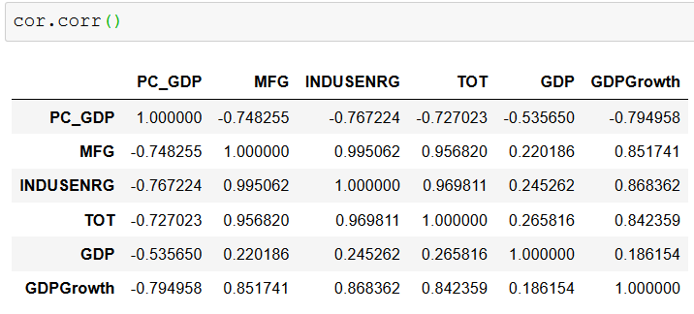
Statistical Exploration
Manufacturing and Industry activities seem to be correlated with each other. (0.99)
Manufacturing is selected as an indicator.
The correlation between current account and GDP is calculated. Although GDPGrowth is more correlated with current account, GDP is selected as an indicator.
Because: GDPGrowth is highly correlated with growth rate of value-added activities.

Slide 6
ML Methods
Logistic or linear regression can be used;
To analyze the relation between economic indicators and current account
To forecast current account through certain weight that are assigned to economic indicators
KNN model can be used as a result of researches in the future

Slide 7
Sezgi Altun
Muhammed Ali Metin
Alperen Yıldız
Aşkın Caner Akkuş
Feyzi Bağbozan
Barış Koç

